Slide 1
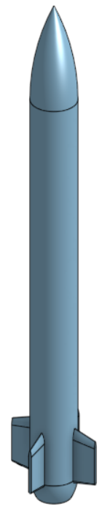










Body Velocities: $V={\left[\begin{matrix}u & v & w\end{matrix}\right]}^{T}$
$$u$$
$$p$$
$$w$$
$$r$$
$$z_{G}$$
$$q$$
$$v$$
$$y_{G}$$
$$x_{G}$$

Slide 2
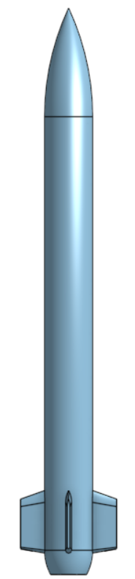






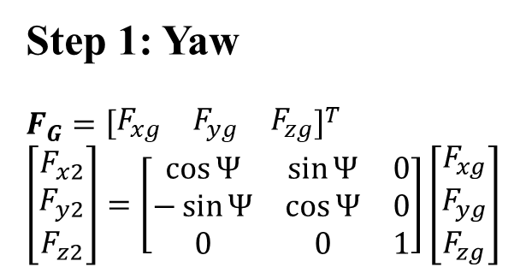
Step 1: Yaw
$$F_{G}={\left[\begin{matrix}F_{xg} & F_{yg} & F_{zg}\end{matrix}\right]}^{T}$$
$$\left[\begin{matrix}F_{x2} \\ F_{y2} \\ F_{z2}\end{matrix}\right]=\left[\begin{matrix}\cos{Ψ} & \sin{Ψ} & 0 \\ −\sin{Ψ} & \cos{Ψ} & 0 \\ 0 & 0 & 1\end{matrix}\right]\left[\begin{matrix}F_{xg} \\ F_{yg} \\ F_{zg}\end{matrix}\right]$$
$$X_{g}$$
$$Ψ$$
$$X_{2}$$
$$Ψ$$
$$Y_{g}$$
$$Y_{2}$$

Slide 3






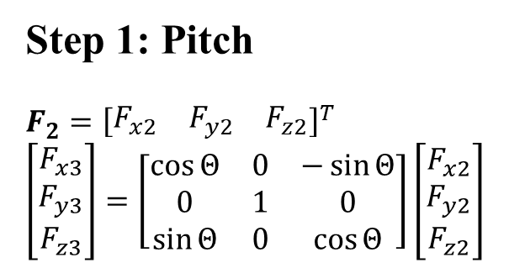
Step 1: Pitch
$$F_{2}={\left[\begin{matrix}F_{x2} & F_{y2} & F_{z2}\end{matrix}\right]}^{T}$$
$$\left[\begin{matrix}F_{x3} \\ F_{y3} \\ F_{z3}\end{matrix}\right]=\left[\begin{matrix}\cos{Θ} & 0 & −\sin{Θ} \\ 0 & 1 & 0 \\ \sin{Θ} & 0 & \cos{Θ}\end{matrix}\right]\left[\begin{matrix}F_{x2} \\ F_{y2} \\ F_{z2}\end{matrix}\right]$$
$$Z_{3}$$
$$Θ$$
$$Z_{2}$$
$$X_{2}$$
$$Θ$$
$$X_{3}$$

Slide 4
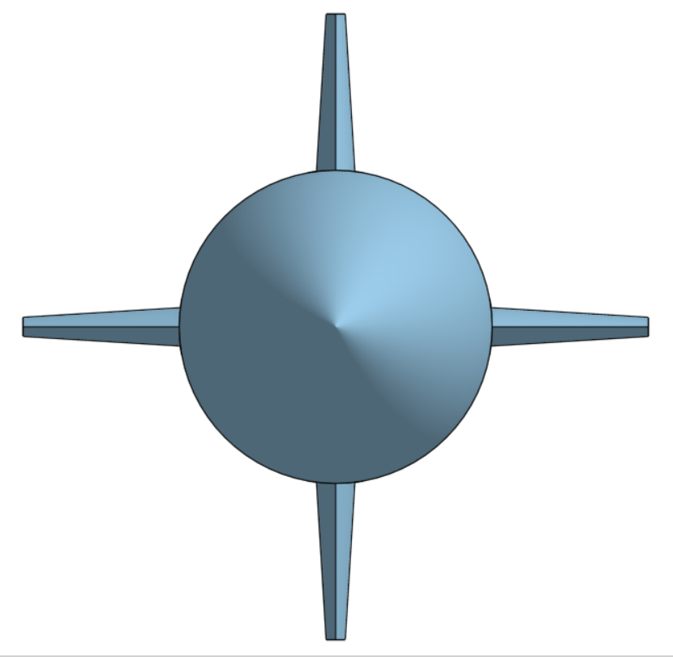






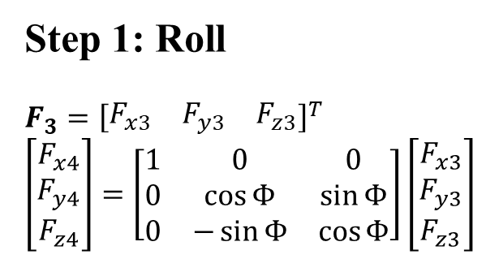
Step 1: Roll
$$F_{3}={\left[\begin{matrix}F_{x3} & F_{y3} & F_{z3}\end{matrix}\right]}^{T}$$
$$\left[\begin{matrix}F_{x4} \\ F_{y4} \\ F_{z4}\end{matrix}\right]=\left[\begin{matrix}1 & 0 & 0 \\ 0 & \cos{Φ} & \sin{Φ} \\ 0 & −\sin{Φ} & \cos{Φ}\end{matrix}\right]\left[\begin{matrix}F_{x3} \\ F_{y3} \\ F_{z3}\end{matrix}\right]$$
$$Z_{3}$$
$$Φ$$
$$Z$$
$$Y_{3}$$
$$Φ$$
$$Y$$

Slide 5
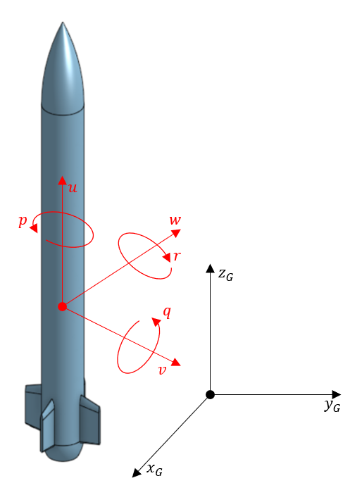
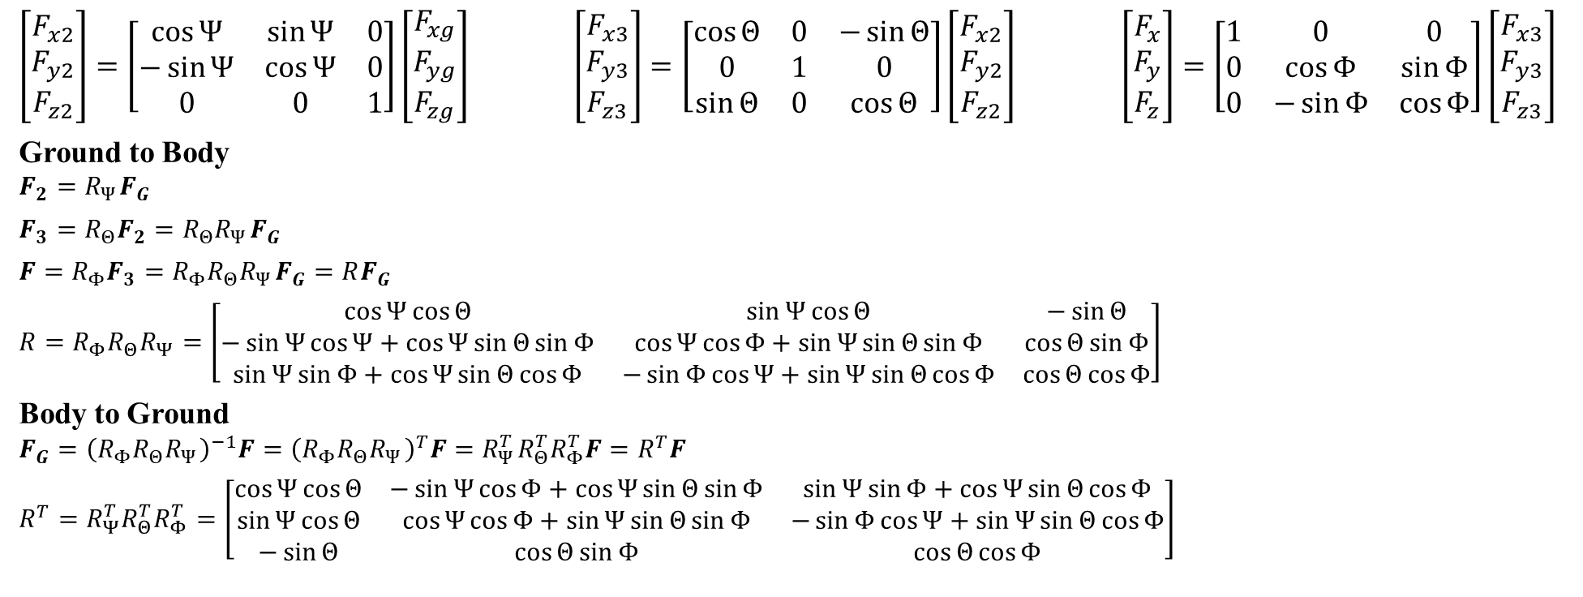



$$R_{Ψ}$$
$$R_{Θ}$$
$$R_{Φ}$$
$\left[\begin{matrix}F_{x2} \\ F_{y2} \\ F_{z2}\end{matrix}\right]=\left[\begin{matrix}\cos{Ψ} & \sin{Ψ} & 0 \\ −\sin{Ψ} & \cos{Ψ} & 0 \\ 0 & 0 & 1\end{matrix}\right]\left[\begin{matrix}F_{xg} \\ F_{yg} \\ F_{zg}\end{matrix}\right]$ $\left[\begin{matrix}F_{x3} \\ F_{y3} \\ F_{z3}\end{matrix}\right]=\left[\begin{matrix}\cos{Θ} & 0 & −\sin{Θ} \\ 0 & 1 & 0 \\ \sin{Θ} & 0 & \cos{Θ}\end{matrix}\right]\left[\begin{matrix}F_{x2} \\ F_{y2} \\ F_{z2}\end{matrix}\right]$ $\left[\begin{matrix}F_{x} \\ F_{y} \\ F_{z}\end{matrix}\right]=\left[\begin{matrix}1 & 0 & 0 \\ 0 & \cos{Φ} & \sin{Φ} \\ 0 & −\sin{Φ} & \cos{Φ}\end{matrix}\right]\left[\begin{matrix}F_{x3} \\ F_{y3} \\ F_{z3}\end{matrix}\right]$
Ground to Body
$$F_{2}=R_{Ψ}F_{G}$$
$$F_{3}=R_{Θ}F_{2}=R_{Θ}R_{Ψ}F_{G}$$
$$F=R_{Φ}F_{3}=R_{Φ}R_{Θ}R_{Ψ}F_{G}=RF_{G}$$
$$R=R_{Φ}R_{Θ}R_{Ψ}=\left[\begin{matrix}\cos{Ψ}\cos{Θ} & \sin{Ψ}\cos{Θ} & −\sin{Θ} \\ −\sin{Ψ}\cos{Ψ+\cos{Ψ}\sin{Θ}\sin{Φ}} & \cos{Ψ}\cos{Φ}+\sin{Ψ}\sin{Θ}\sin{Φ} & \cos{Θ}\sin{Φ} \\ \sin{Ψ}\sin{Φ}+\cos{Ψ}\sin{Θ}\cos{Φ} & −\sin{Φ}\cos{Ψ}+\sin{Ψ}\sin{Θ}\cos{Φ} & \cos{Θ}\cos{Φ}\end{matrix}\right]$$
Body to Ground
$$F_{G}={\left(R_{Φ}R_{Θ}R_{Ψ}\right)}^{−1}F={\left(R_{Φ}R_{Θ}R_{Ψ}\right)}^{T}F=R_{Ψ}^{T}R_{Θ}^{T}R_{Φ}^{T}F=R^{T}F$$
$$R^{T}=R_{Ψ}^{T}R_{Θ}^{T}R_{Φ}^{T}=\left[\begin{matrix}\cos{Ψ}\cos{Θ} & −\sin{Ψ}\cos{Φ}+\cos{Ψ}\sin{Θ}\sin{Φ} & \sin{Ψ}\sin{Φ}+\cos{Ψ}\sin{Θ}\cos{Φ} \\ \sin{Ψ}\cos{Θ} & \cos{Ψ}\cos{Φ}+\sin{Ψ}\sin{Θ}\sin{Φ} & −\sin{Φ}\cos{Ψ+\sin{Ψ}\sin{Θ}\cos{Φ}} \\ −\sin{Θ} & \cos{Θ}\sin{Φ} & \cos{Θ}\cos{Φ}\end{matrix}\right]$$

Slide 6
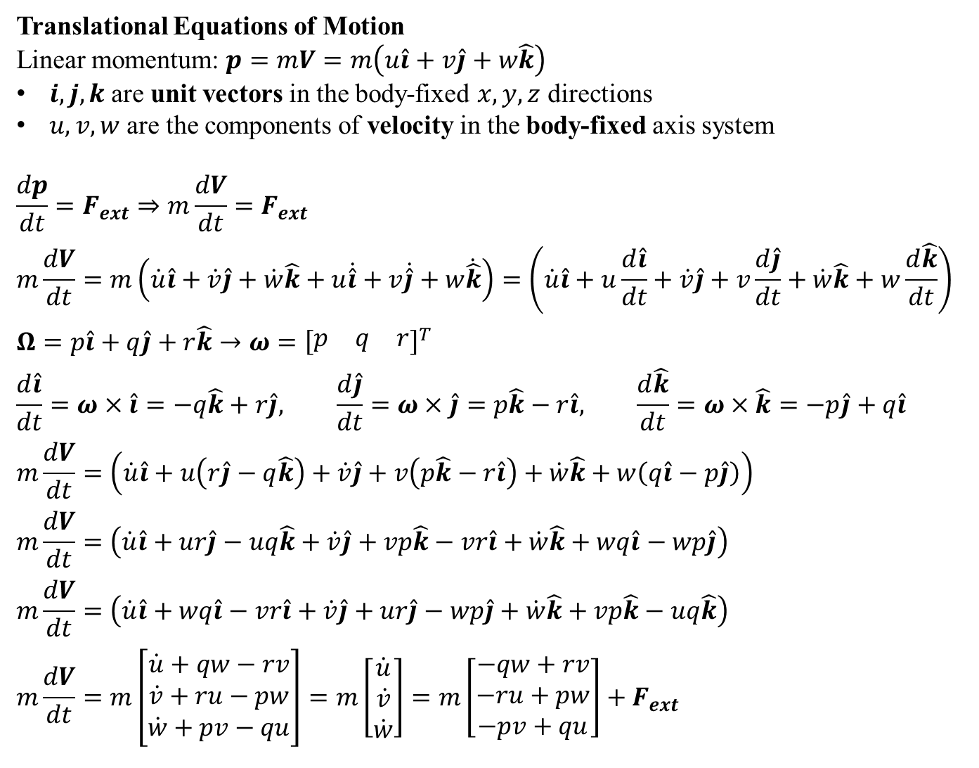
Translational Equations of Motion
Linear momentum: $p=mV=m\left(u\hat{i}+v\hat{j}+w\hat{k}\right)$
$i,j,k$ are unit vectors in the body-fixed $x,y,z$ directions
$u,v,w$ are the components of velocity in the body-fixed axis system
$$\frac{dp}{dt}=F_{ext}⇒m\frac{dV}{dt}=F_{ext}$$
$$m\frac{dV}{dt}=m\left(\dot{u}\hat{i}+\dot{v}\hat{j}+\dot{w}\hat{k}+u\dot{\hat{i}}+v\dot{\hat{j}}+w\dot{\hat{k}}\right)=\left(\dot{u}\hat{i}+u\frac{d\hat{i}}{dt}+\dot{v}\hat{j}+v\frac{d\hat{j}}{dt}+\dot{w}\hat{k}+w\frac{d\hat{k}}{dt}\right)$$
$$Ω=p\hat{i}+q\hat{j}+r\hat{k}→ω={\left[\begin{matrix}p & q & r\end{matrix}\right]}^{T}$$
$$\frac{d\hat{i}}{dt}=ω×\hat{i}=−q\hat{k}+r\hat{j}, \frac{d\hat{j}}{dt}=ω×\hat{j}=p\hat{k}−r\hat{i}, \frac{d\hat{k}}{dt}=ω×\hat{k}=−p\hat{j}+q\hat{i}$$
$$m\frac{dV}{dt}=\left(\dot{u}\hat{i}+u\left(r\hat{j}−q\hat{k}\right)+\dot{v}\hat{j}+v\left(p\hat{k}−r\hat{i}\right)+\dot{w}\hat{k}+w\left(q\hat{i}−p\hat{j}\right)\right)$$
$$m\frac{dV}{dt}=\left(\dot{u}\hat{i}+ur\hat{j}−uq\hat{k}+\dot{v}\hat{j}+vp\hat{k}−vr\hat{i}+\dot{w}\hat{k}+wq\hat{i}−wp\hat{j}\right)$$
$$m\frac{dV}{dt}=\left(\dot{u}\hat{i}+wq\hat{i}−vr\hat{i}+\dot{v}\hat{j}+ur\hat{j}−wp\hat{j}+\dot{w}\hat{k}+vp\hat{k}−uq\hat{k}\right)$$
$$m\frac{dV}{dt}=m\left[\begin{matrix}\dot{u}+qw−rv \\ \dot{v}+ru−pw \\ \dot{w}+pv−qu\end{matrix}\right]=m\left[\begin{matrix}\dot{u} \\ \dot{v} \\ \dot{w}\end{matrix}\right]=m\left[\begin{matrix}−qw+rv \\ −ru+pw \\ −pv+qu\end{matrix}\right]+F_{ext}$$

Slide 7
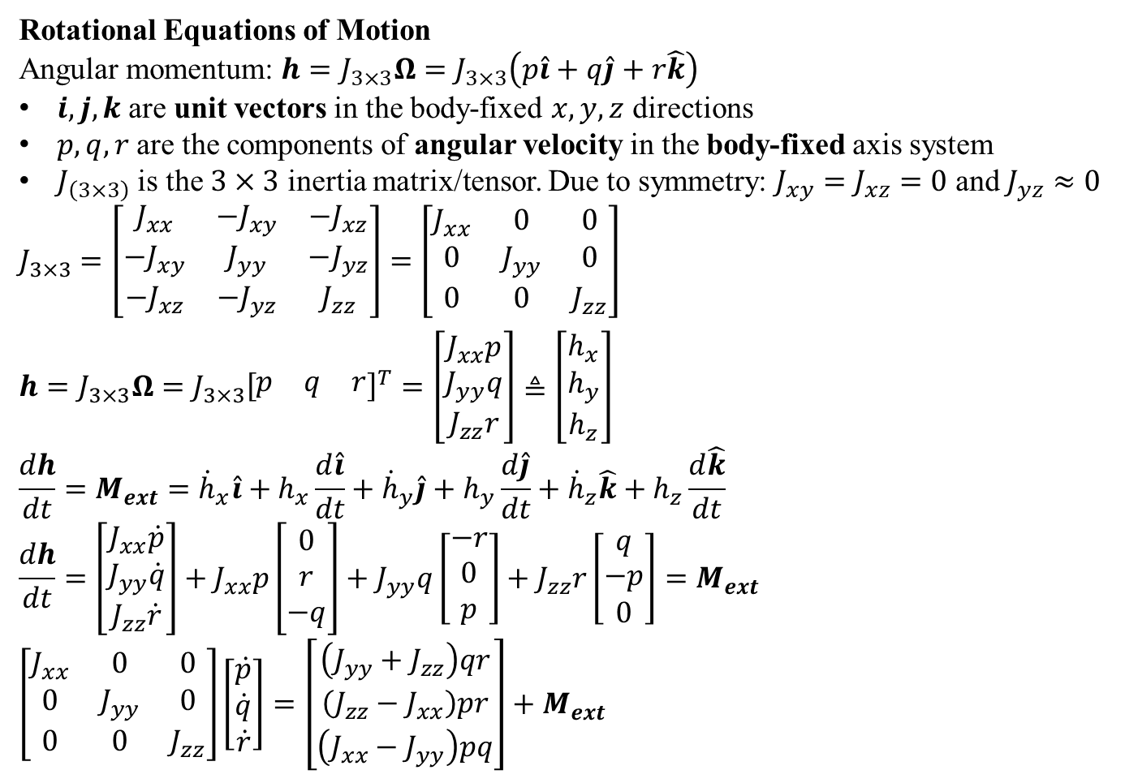
Rotational Equations of Motion
Angular momentum: $h=J_{3×3}Ω=J_{3×3}\left(p\hat{i}+q\hat{j}+r\hat{k}\right)$
$i,j,k$ are unit vectors in the body-fixed $x,y,z$ directions
$p,q,r$ are the components of angular velocity in the body-fixed axis system
$J_{\left(3×3\right)}$ is the $3×3$ inertia matrix/tensor. Due to symmetry: $J_{xy}=J_{xz}=0$ and $J_{yz}≈0$
$$J_{3×3}=\left[\begin{matrix}J_{xx} & −J_{xy} & −J_{xz} \\ −J_{xy} & J_{yy} & −J_{yz} \\ −J_{xz} & −J_{yz} & J_{zz}\end{matrix}\right]=\left[\begin{matrix}J_{xx} & 0 & 0 \\ 0 & J_{yy} & 0 \\ 0 & 0 & J_{zz}\end{matrix}\right]$$
$$h=J_{3×3}Ω=J_{3×3}{\left[\begin{matrix}p & q & r\end{matrix}\right]}^{T}=\left[\begin{matrix}J_{xx}p \\ J_{yy}q \\ J_{zz}r\end{matrix}\right]≜\left[\begin{matrix}h_{x} \\ h_{y} \\ h_{z}\end{matrix}\right]$$
$$\frac{dh}{dt}=M_{ext}={\dot{h}}_{x}\hat{i}+h_{x}\frac{d\hat{i}}{dt}+{\dot{h}}_{y}\hat{j}+h_{y}\frac{d\hat{j}}{dt}+{\dot{h}}_{z}\hat{k}+h_{z}\frac{d\hat{k}}{dt}$$
$$\frac{dh}{dt}=\left[\begin{matrix}J_{xx}\dot{p} \\ J_{yy}\dot{q} \\ J_{zz}\dot{r}\end{matrix}\right]+J_{xx}p\left[\begin{matrix}0 \\ r \\ −q\end{matrix}\right]+J_{yy}q\left[\begin{matrix}−r \\ 0 \\ p\end{matrix}\right]+J_{zz}r\left[\begin{matrix}q \\ −p \\ 0\end{matrix}\right]=M_{ext}$$
$$\left[\begin{matrix}J_{xx} & 0 & 0 \\ 0 & J_{yy} & 0 \\ 0 & 0 & J_{zz}\end{matrix}\right]\left[\begin{matrix}\dot{p} \\ \dot{q} \\ \dot{r}\end{matrix}\right]=\left[\begin{matrix}\left(J_{yy}+J_{zz}\right)qr \\ \left(J_{zz}−J_{xx}\right)pr \\ \left(J_{xx}−J_{yy}\right)pq\end{matrix}\right]+M_{ext}$$

Slide 8
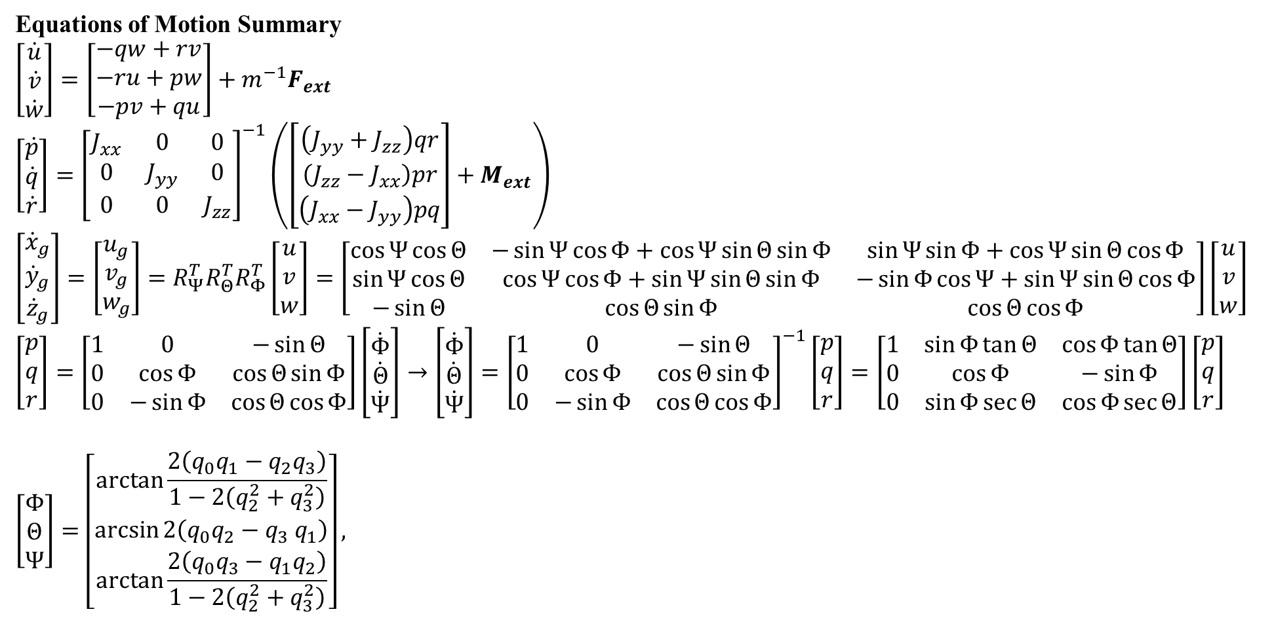
Equations of Motion Summary
$$\left[\begin{matrix}\dot{u} \\ \dot{v} \\ \dot{w}\end{matrix}\right]=\left[\begin{matrix}−qw+rv \\ −ru+pw \\ −pv+qu\end{matrix}\right]+m^{−1}F_{ext}$$
$$\left[\begin{matrix}\dot{p} \\ \dot{q} \\ \dot{r}\end{matrix}\right]={\left[\begin{matrix}J_{xx} & 0 & 0 \\ 0 & J_{yy} & 0 \\ 0 & 0 & J_{zz}\end{matrix}\right]}^{−1}\left(\left[\begin{matrix}\left(J_{yy}+J_{zz}\right)qr \\ \left(J_{zz}−J_{xx}\right)pr \\ \left(J_{xx}−J_{yy}\right)pq\end{matrix}\right]+M_{ext}\right)$$
$$\left[\begin{matrix}{\dot{x}}_{g} \\ {\dot{y}}_{g} \\ {\dot{z}}_{g}\end{matrix}\right]=\left[\begin{matrix}u_{g} \\ v_{g} \\ w_{g}\end{matrix}\right]=R_{Ψ}^{T}R_{Θ}^{T}R_{Φ}^{T}\left[\begin{matrix}u \\ v \\ w\end{matrix}\right]=\left[\begin{matrix}\cos{Ψ}\cos{Θ} & −\sin{Ψ}\cos{Φ}+\cos{Ψ}\sin{Θ}\sin{Φ} & \sin{Ψ}\sin{Φ}+\cos{Ψ}\sin{Θ}\cos{Φ} \\ \sin{Ψ}\cos{Θ} & \cos{Ψ}\cos{Φ}+\sin{Ψ}\sin{Θ}\sin{Φ} & −\sin{Φ}\cos{Ψ+\sin{Ψ}\sin{Θ}\cos{Φ}} \\ −\sin{Θ} & \cos{Θ}\sin{Φ} & \cos{Θ}\cos{Φ}\end{matrix}\right]\left[\begin{matrix}u \\ v \\ w\end{matrix}\right]$$
$$\left[\begin{matrix}p \\ q \\ r\end{matrix}\right]=\left[\begin{matrix}1 & 0 & −\sin{Θ} \\ 0 & \cos{Φ} & \cos{Θ}\sin{Φ} \\ 0 & −\sin{Φ} & \cos{Θ}\cos{Φ}\end{matrix}\right]\left[\begin{matrix}\dot{Φ} \\ \dot{Θ} \\ \dot{Ψ}\end{matrix}\right]→\left[\begin{matrix}\dot{Φ} \\ \dot{Θ} \\ \dot{Ψ}\end{matrix}\right]={\left[\begin{matrix}1 & 0 & −\sin{Θ} \\ 0 & \cos{Φ} & \cos{Θ}\sin{Φ} \\ 0 & −\sin{Φ} & \cos{Θ}\cos{Φ}\end{matrix}\right]}^{−1}\left[\begin{matrix}p \\ q \\ r\end{matrix}\right]=\left[\begin{matrix}1 & \sin{Φ}\tan{Θ} & \cos{Φ}\tan{Θ} \\ 0 & \cos{Φ} & −\sin{Φ} \\ 0 & \sin{Φ}\sec{Θ} & \cos{Φ}\sec{Θ}\end{matrix}\right]\left[\begin{matrix}p \\ q \\ r\end{matrix}\right]$$
$$\left[\begin{matrix}Φ \\ Θ \\ Ψ\end{matrix}\right]=\left[\begin{matrix}\arctan{\frac{2\left(q_{0}q_{1}−q_{2}q_{3}\right)}{1−2\left(q_{2}^{2}+q_{3}^{2}\right)}} \\ \arcsin{2\left(q_{0}q_{2}−q_{3} q_{1}\right)} \\ \arctan{\frac{2\left(q_{0}q_{3}−q_{1}q_{2}\right)}{1−2\left(q_{2}^{2}+q_{3}^{2}\right)}}\end{matrix}\right],$$

